Slide 1

Agile Vocabulary Series Scrum Smells What are Scrum Smells? Four Minute Video by Joel H. Robinson Scrum Master

Slide 2
Scrum “Smell” Defined
Have you heard the Agile term “Scrum Smells”? What does it mean?
Scrum Smell describes that uneasy feeling that something might be wrong.

Slide 3
Scrum “Smell” Origins
In his book Refactoring, (1999) Martin Fowler introduced the term smell to refer to something that may not be right.
According to Charles Bradley these are symptoms 'that possibly indicates a deeper problem. It doesn't always mean the bad smell is indicative of a true problem, but most times it is" [Charles Bradley].Aug 21, 2015

Slide 4
Here are a few examples of Scrum “Smells” See if they have a familiar odor to you.

Slide 5
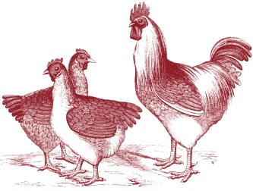
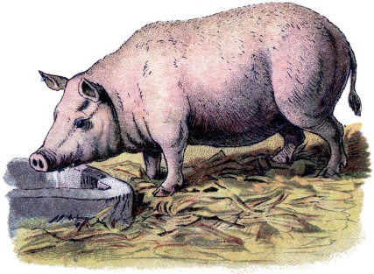
Talking Chickens and Missing Pigs
This example comes from Mike Cohn, Agile blogger and author. Chickens are those outside the development team. Like providers of a bacon and eggs menu, they are interested in the project but offering an “egg”, but their own “bacon” is not at stake.
Pigs are those inside the development team. Like providers of a bacon and eggs menu, their own “bacon” is on the line.

Slide 6
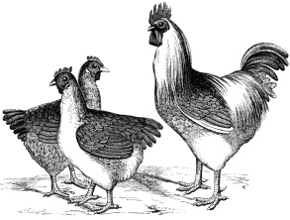
Talking Chickens
During daily stand up meeting people who are “chickens” may listen, but chickens do not interrupt or talk.
Chickens would include Product Owners, stakeholders, upper management, customers, visitors, curious bystanders, and especially, visiting vice-presidents.

Slide 7
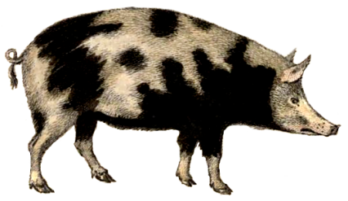
Missing Pigs
Because Pigs are developers, fully committed to the project they are expected to attend daily scrum meeting and share their daily status with other team members for mutual benefit. Remember the daily standup is by the pigs for the pigs.
Pigs do not ‘blow-off’ daily scrum standup meetings.

Slide 8
Product Owner Overreach
When product owners jump in and assign tasks and stories to individual dev team members it may be a “Smell”.
Scrum Dev teams should be self-managed. No one outside the team directs the team. This can be a difficult learning experience for project management teams moving to agile.

Slide 9
Scrum Master becomes Status Master
The daily scrum meeting is not a status report to the scrum master.
Development members are to exchange status and ideas amongst themselves, with the scrum master picking up impediments and verifying that basic scrum rules are being followed. Scrum Master is a coach and a servant leader.
Development members update the scrum boards, burn down charts, and move Kanban post-it notes.

Slide 10
Organization Managerial Overreach
Upper management may feel compelled to ‘help out’ by reassigning team members among scrum teams and rearranging priorities mid-iteration to fit ‘special cases’. This is a smell.
It is important that Scrum Dev teams are purposely empowered by organization management to be self-managed. Teams need to remain intact during a sprint to do their job. Leave them alone.

Slide 11
Conclusion: Fix Scrum Smells before they ‘stink’.
If you have a question or an idea for an Agile video or blog please email me. Also, please visit my blog and subscribe to this YouTube channel. I will be publishing a new video and new blog every week in this series on Agile vocabulary.
CONTACT: joelhrobinson@gmail.com BLOG: www.joelhrobinson.com
YOUTUBE: Search for Joel H. Robinson Scrum Master

